Slide 1

Android Architecture Component
Part of Android Jetpack

Slide 2
Architecture Components What is it ?
A set of android libraries that help you build an application which is writable, testable and maintainable.

Slide 3
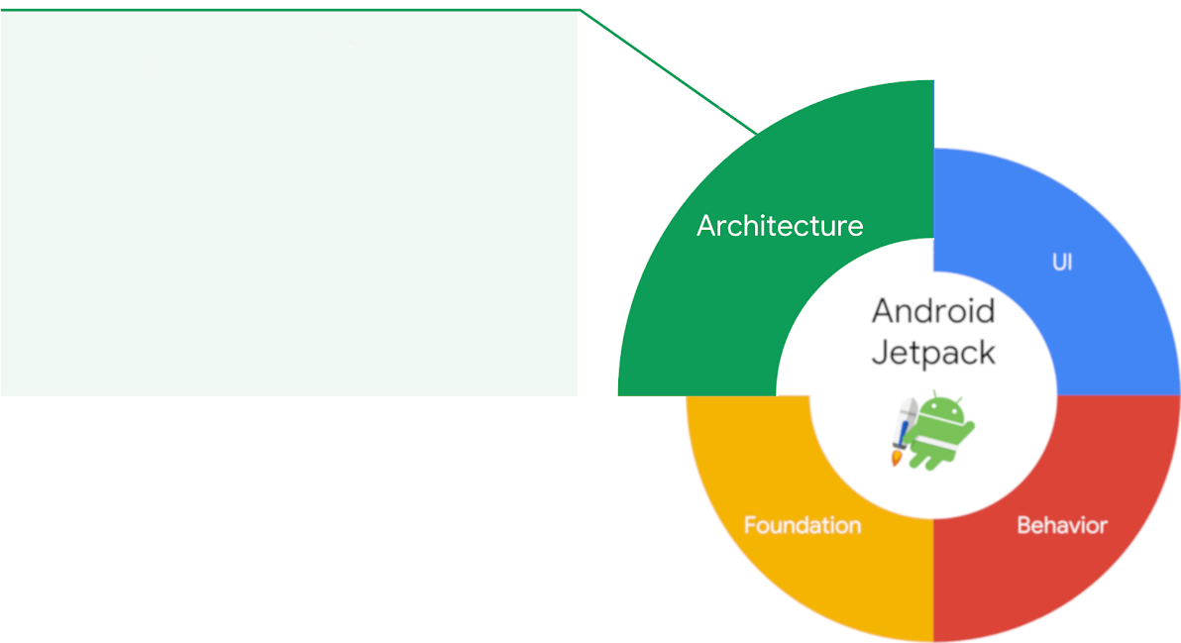
List of component
Data Binding
Lifecycles
Live Data
Navigation (new)
Paging (new)
Room
ViewModel
WorkManager (new)

Slide 4

Data Binding
The Data Binding Library is a support library that allows you to bind UI components in your layouts to data sources in your app using a declarative format rather than programmatically.

Slide 5
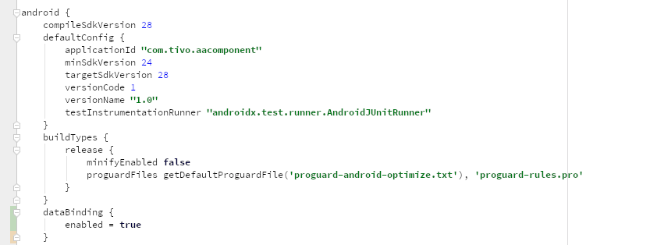
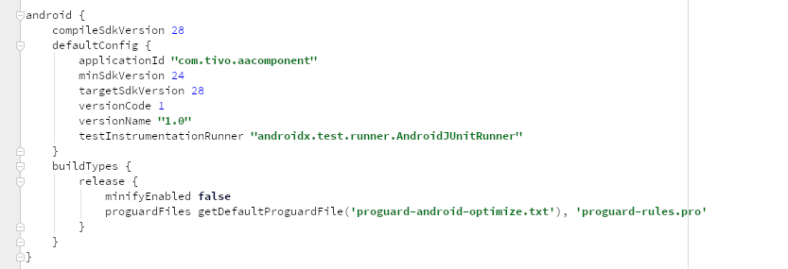
Data Binding Configuration
build.gradle

Slide 6
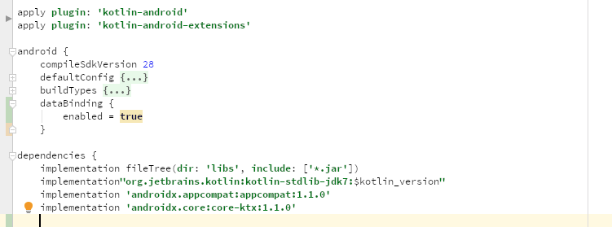
Data Binding for kotlin developer
build.gradle

Slide 7
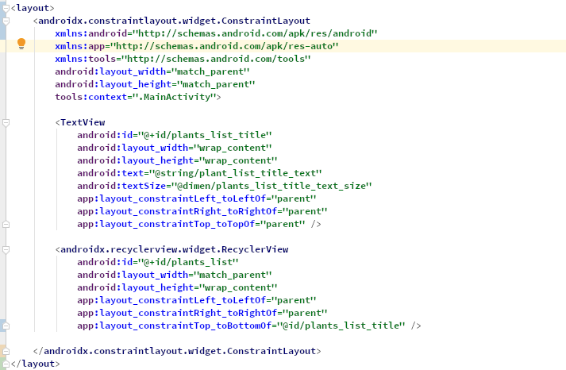
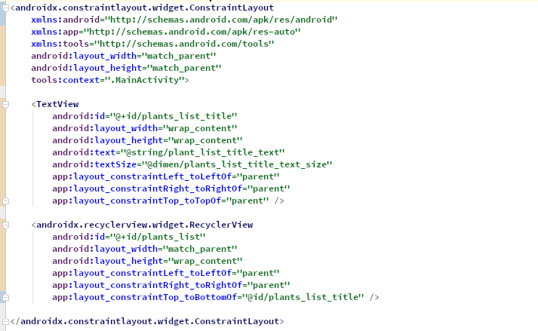
Data Bindind
How to use it
main_activity.xml

Slide 8
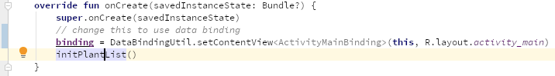
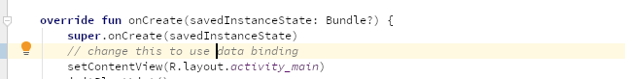
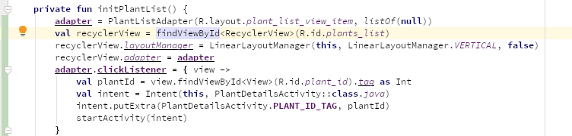
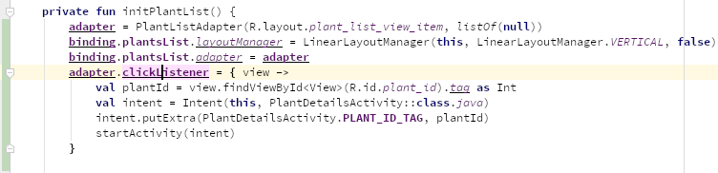
Data Bindind
How to use it
MainActivity.kt

Slide 9
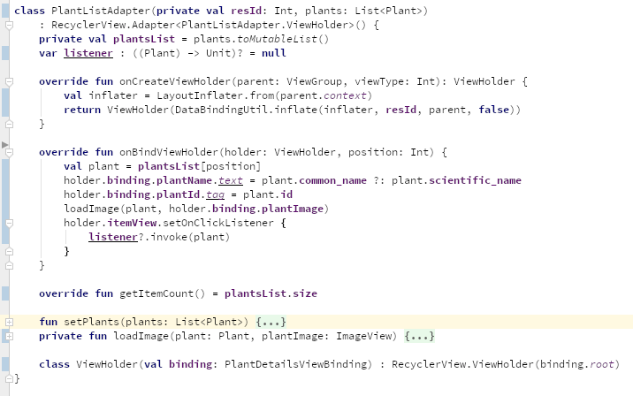
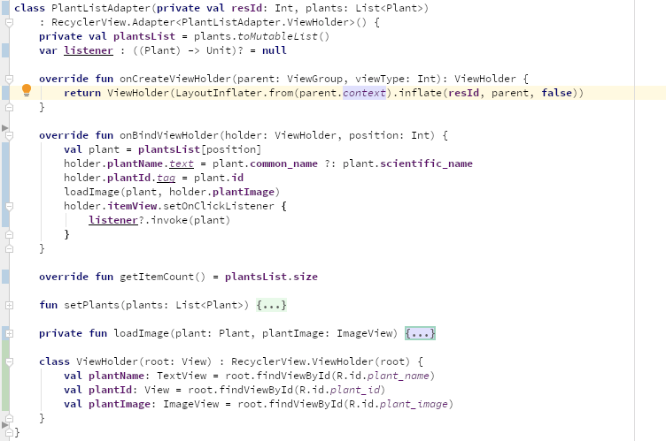
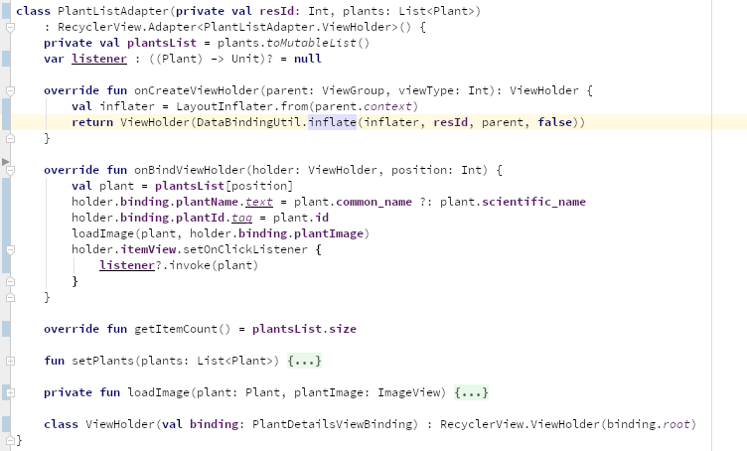
Data Bindind
Use in RecyclerView Adapter
PlantListAdapter.kt

Slide 10
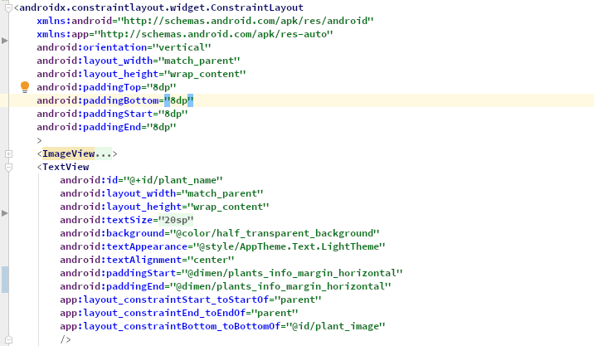
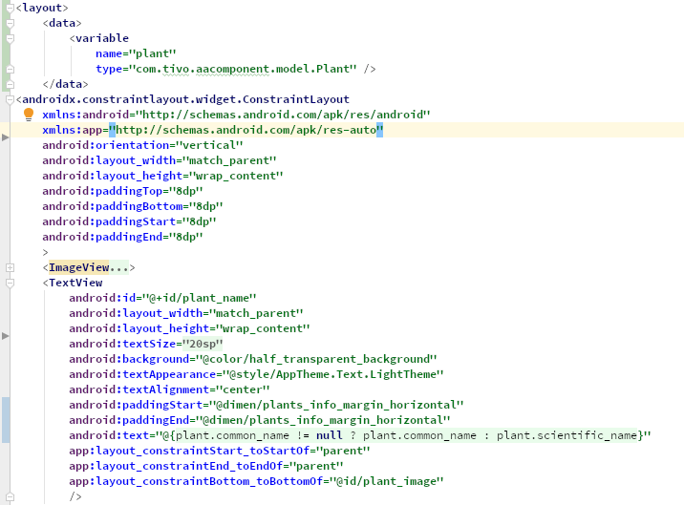
Data Bindind
Use in RecyclerView Adapter
plant_list_view_item.xml

Slide 11
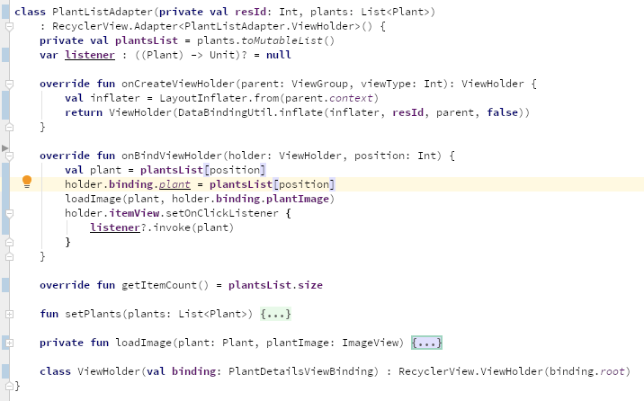
Data Bindind
Use in RecyclerView Adapter
PlantListAdapter.kt

Slide 12
Data Bindind
Use BindingAdapter
@BindigAdapter - annotation to create custom method for any layout attributes
Use only with static method that will be call when attribute will be set in layout
Add @JvmStatic for kotlin

Slide 13
Data Bindind
Use BindingAdapter
You can create BindingAdapter for android attributes like: android:text
You can create BindingAdapter that receive multiple attributes like this: @BindingAdapter(’’first_attr”, ’’second_attr’’)
For multiple attributes you can define that attributes are require or not

Slide 14
Time for example

Slide 15
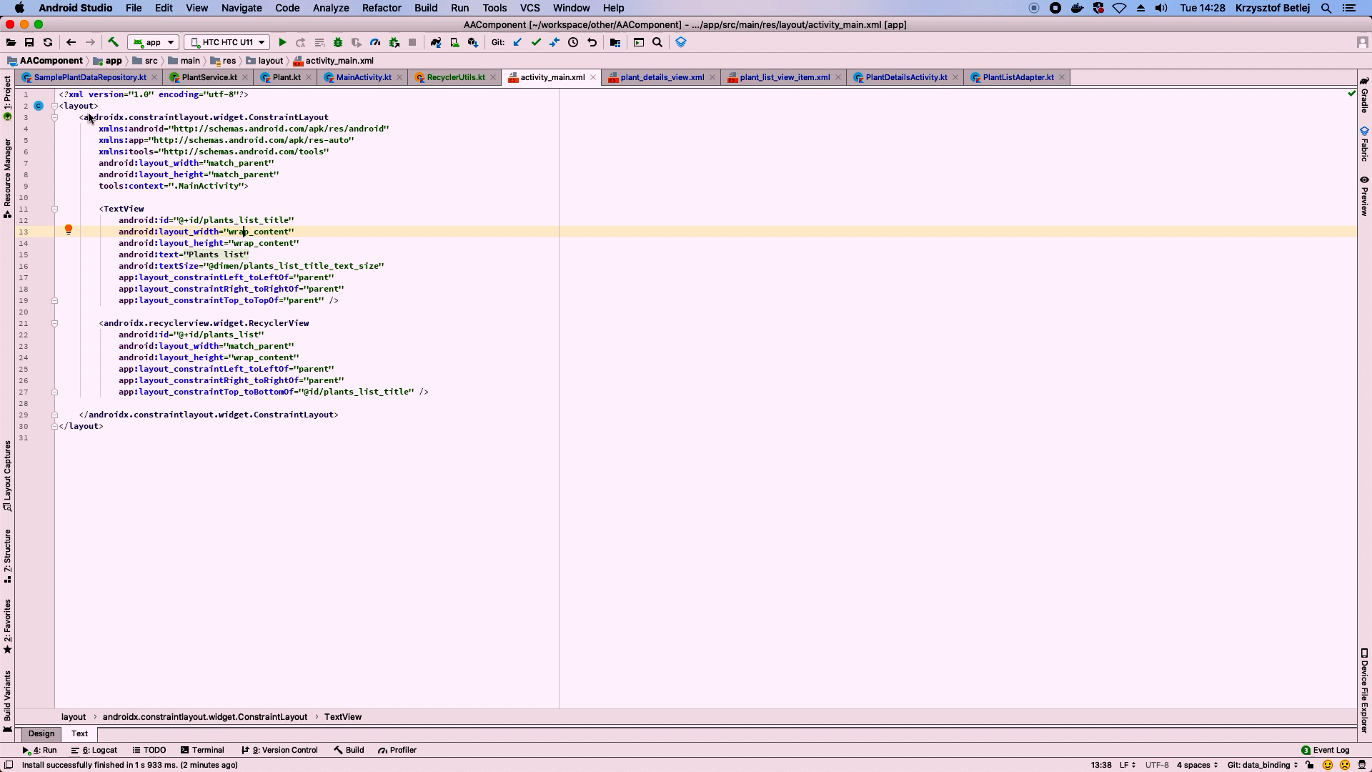
Data Bindind
Use BindingAdapter

Slide 16
Lifecycle component
perform actions in response to a change in the lifecycle status of another component, such as activities and fragments.
help you produce better-organized, and often lighter-weight code, that is easier to maintain.
To use it add androidx.lifecycle dependency to you application

Slide 17
Lifecycle component
Lifecycle
LifecycleOwner

Slide 18
Lifecycle
Lifecycle is a class that holds the information about the lifecycle state of a component (like an activity or a fragment) and allows other objects to observe this state.
Lifecycle uses two main enumerations to track the lifecycle status for its associated component:
Event - the lifecycle events that are dispatched from the framework and the Lifecycle class.
State - the current state of the component tracked by the Lifecycle object.

Slide 19
LifecycleOwner
LifecycleOwner is a single method interface that denotes that the class has a Lifecycle.
It has one method, getLifecycle(), which must be implemented by the class

